Slide 1

Seamless visualisation of complex genomic variations in GMOs and edited cell lines using gmoviz
Kathleen Zeglinski

Slide 2

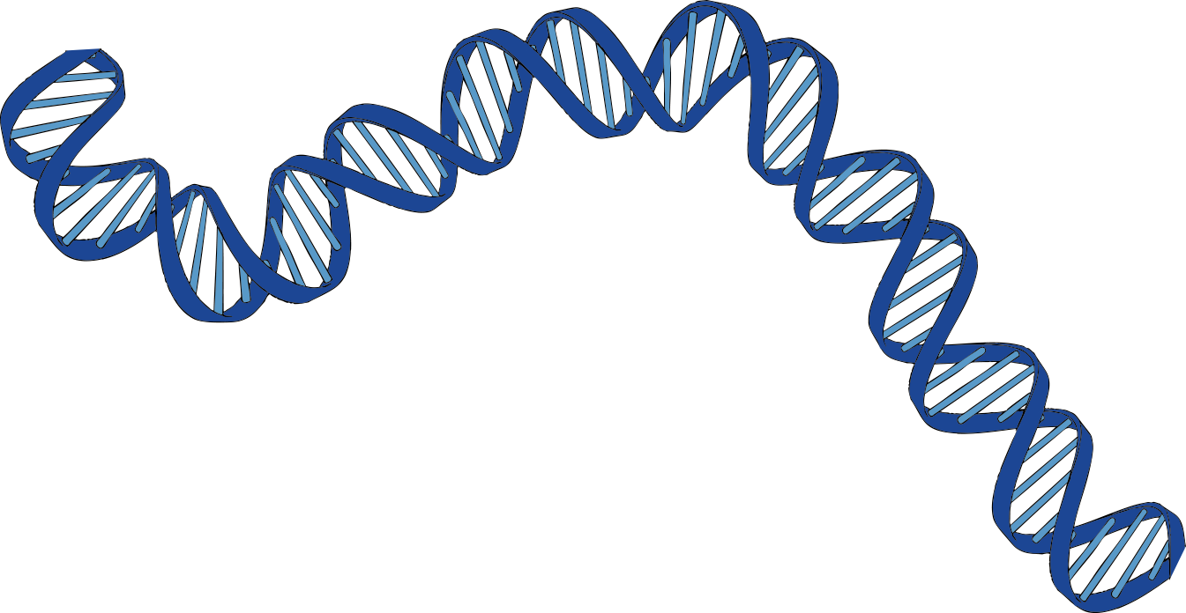
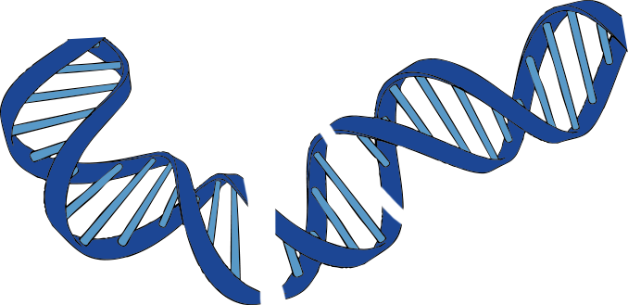
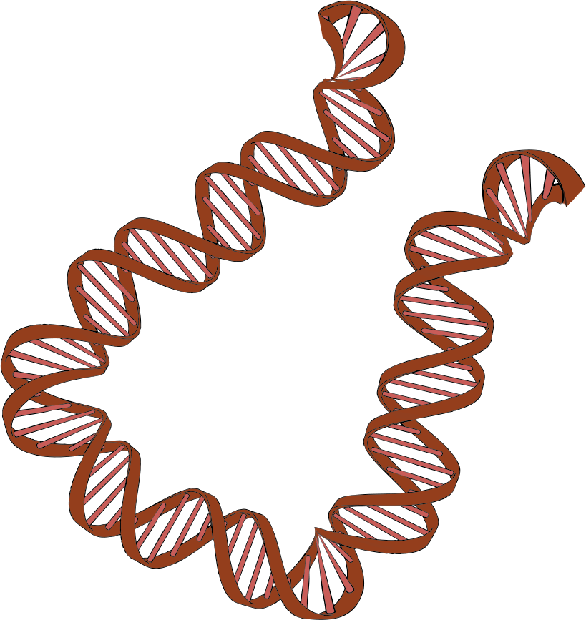


Genetically Modified Organisms (GMOs) are commonly used in biotech research
Edit the DNA
Insert new sequence of interest
Off-target effects

Slide 3
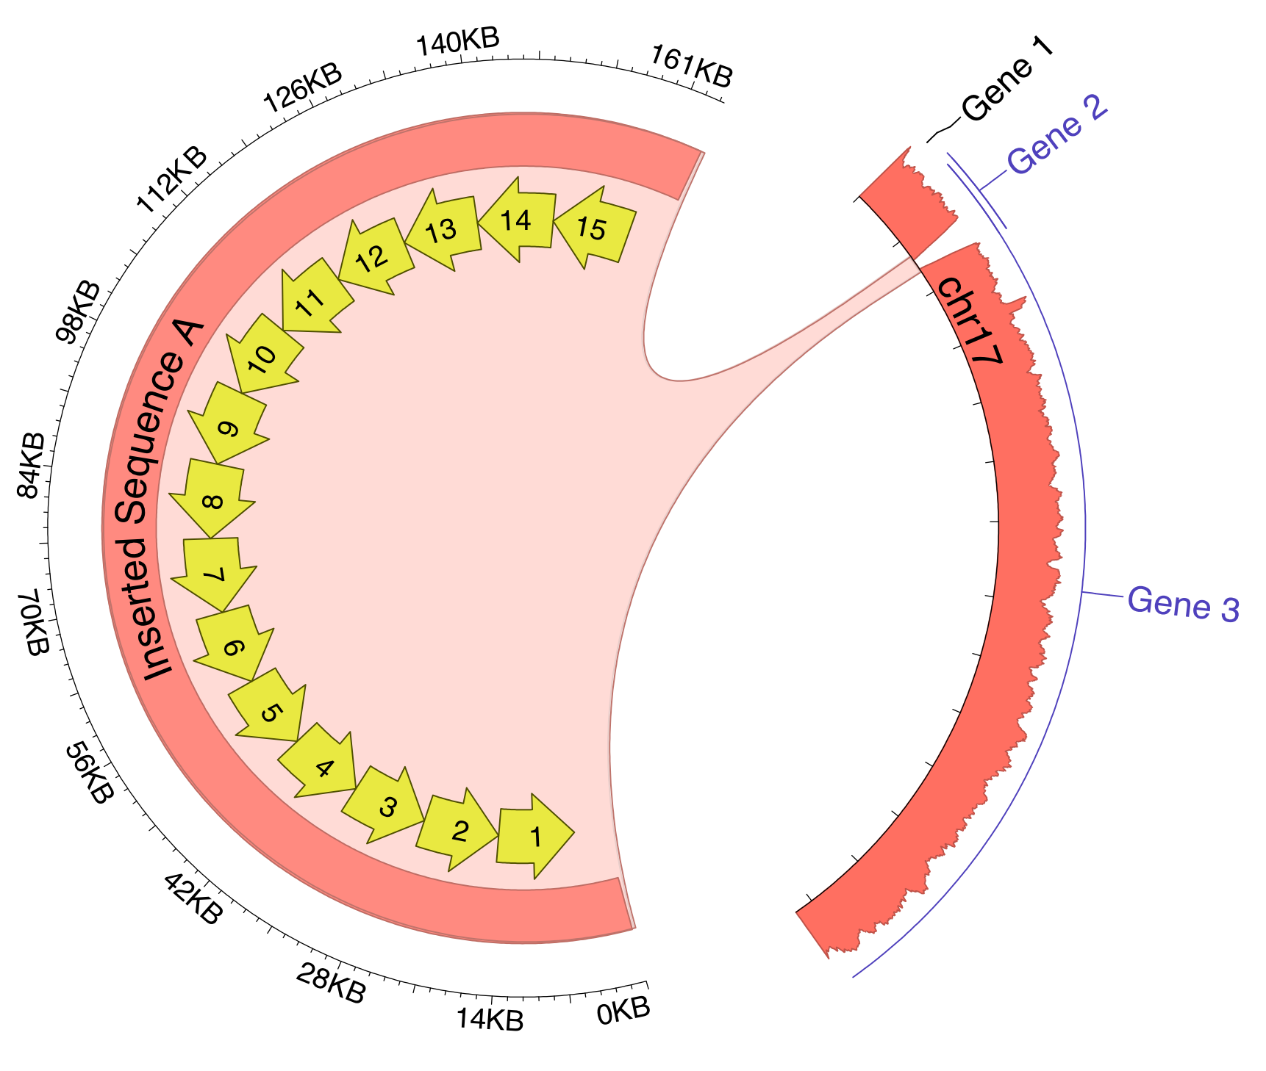
gmoviz integrates high level genomic information
Existing visualisations focus on numeric data, yet in genomic characterisation it is the high-level information that is most important for understanding the GMO
gmoviz uses Circos plots to provide a succinct integrated visualization of multiple high-dimensional data types

Slide 4

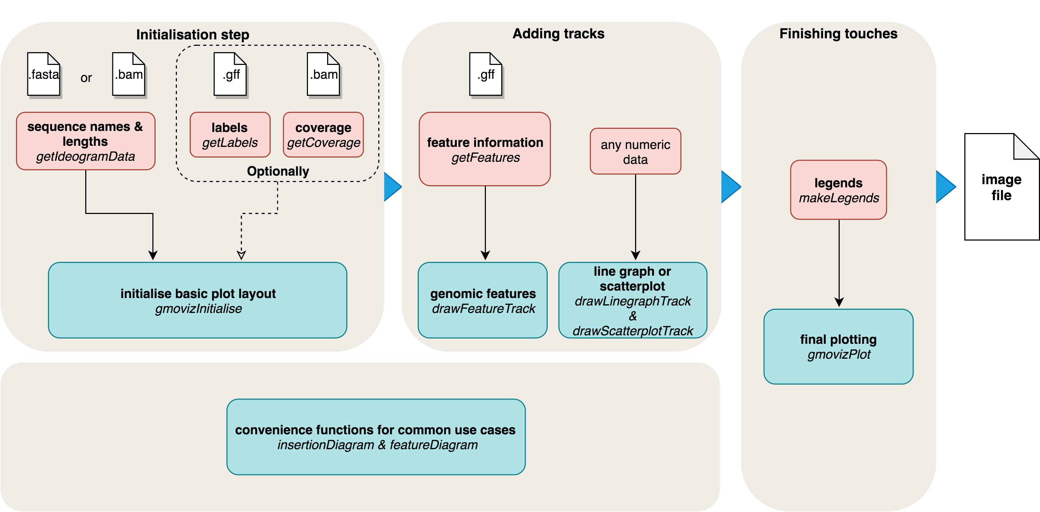

gmoviz package architecture

Slide 5
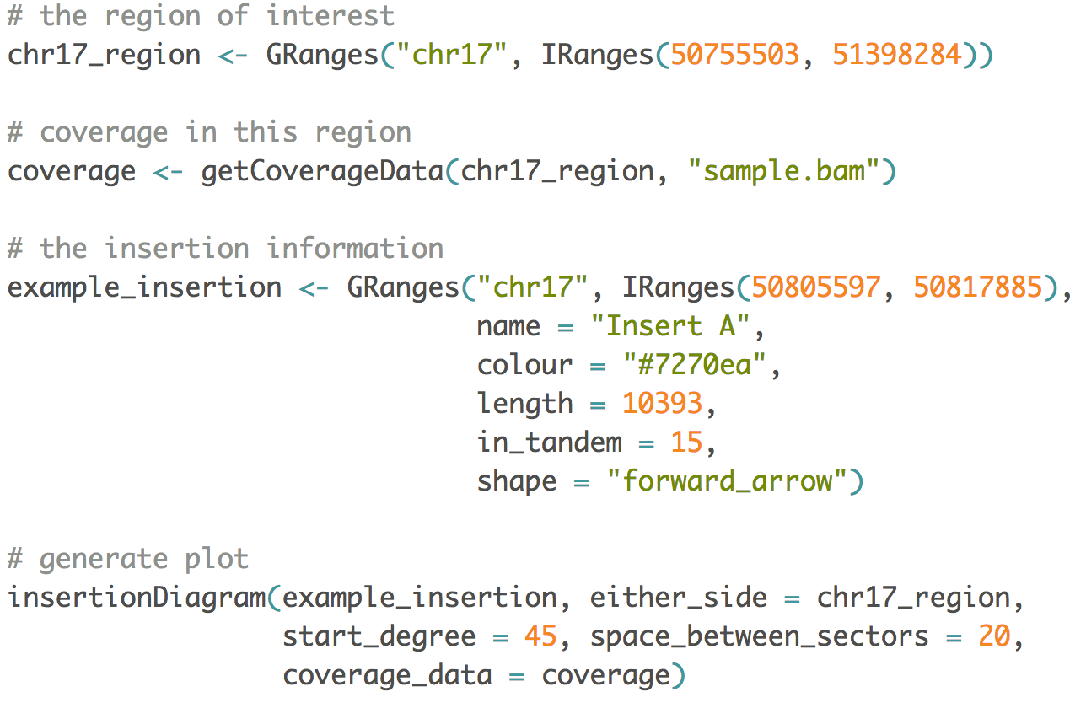
gmoviz is easy to use

Slide 6
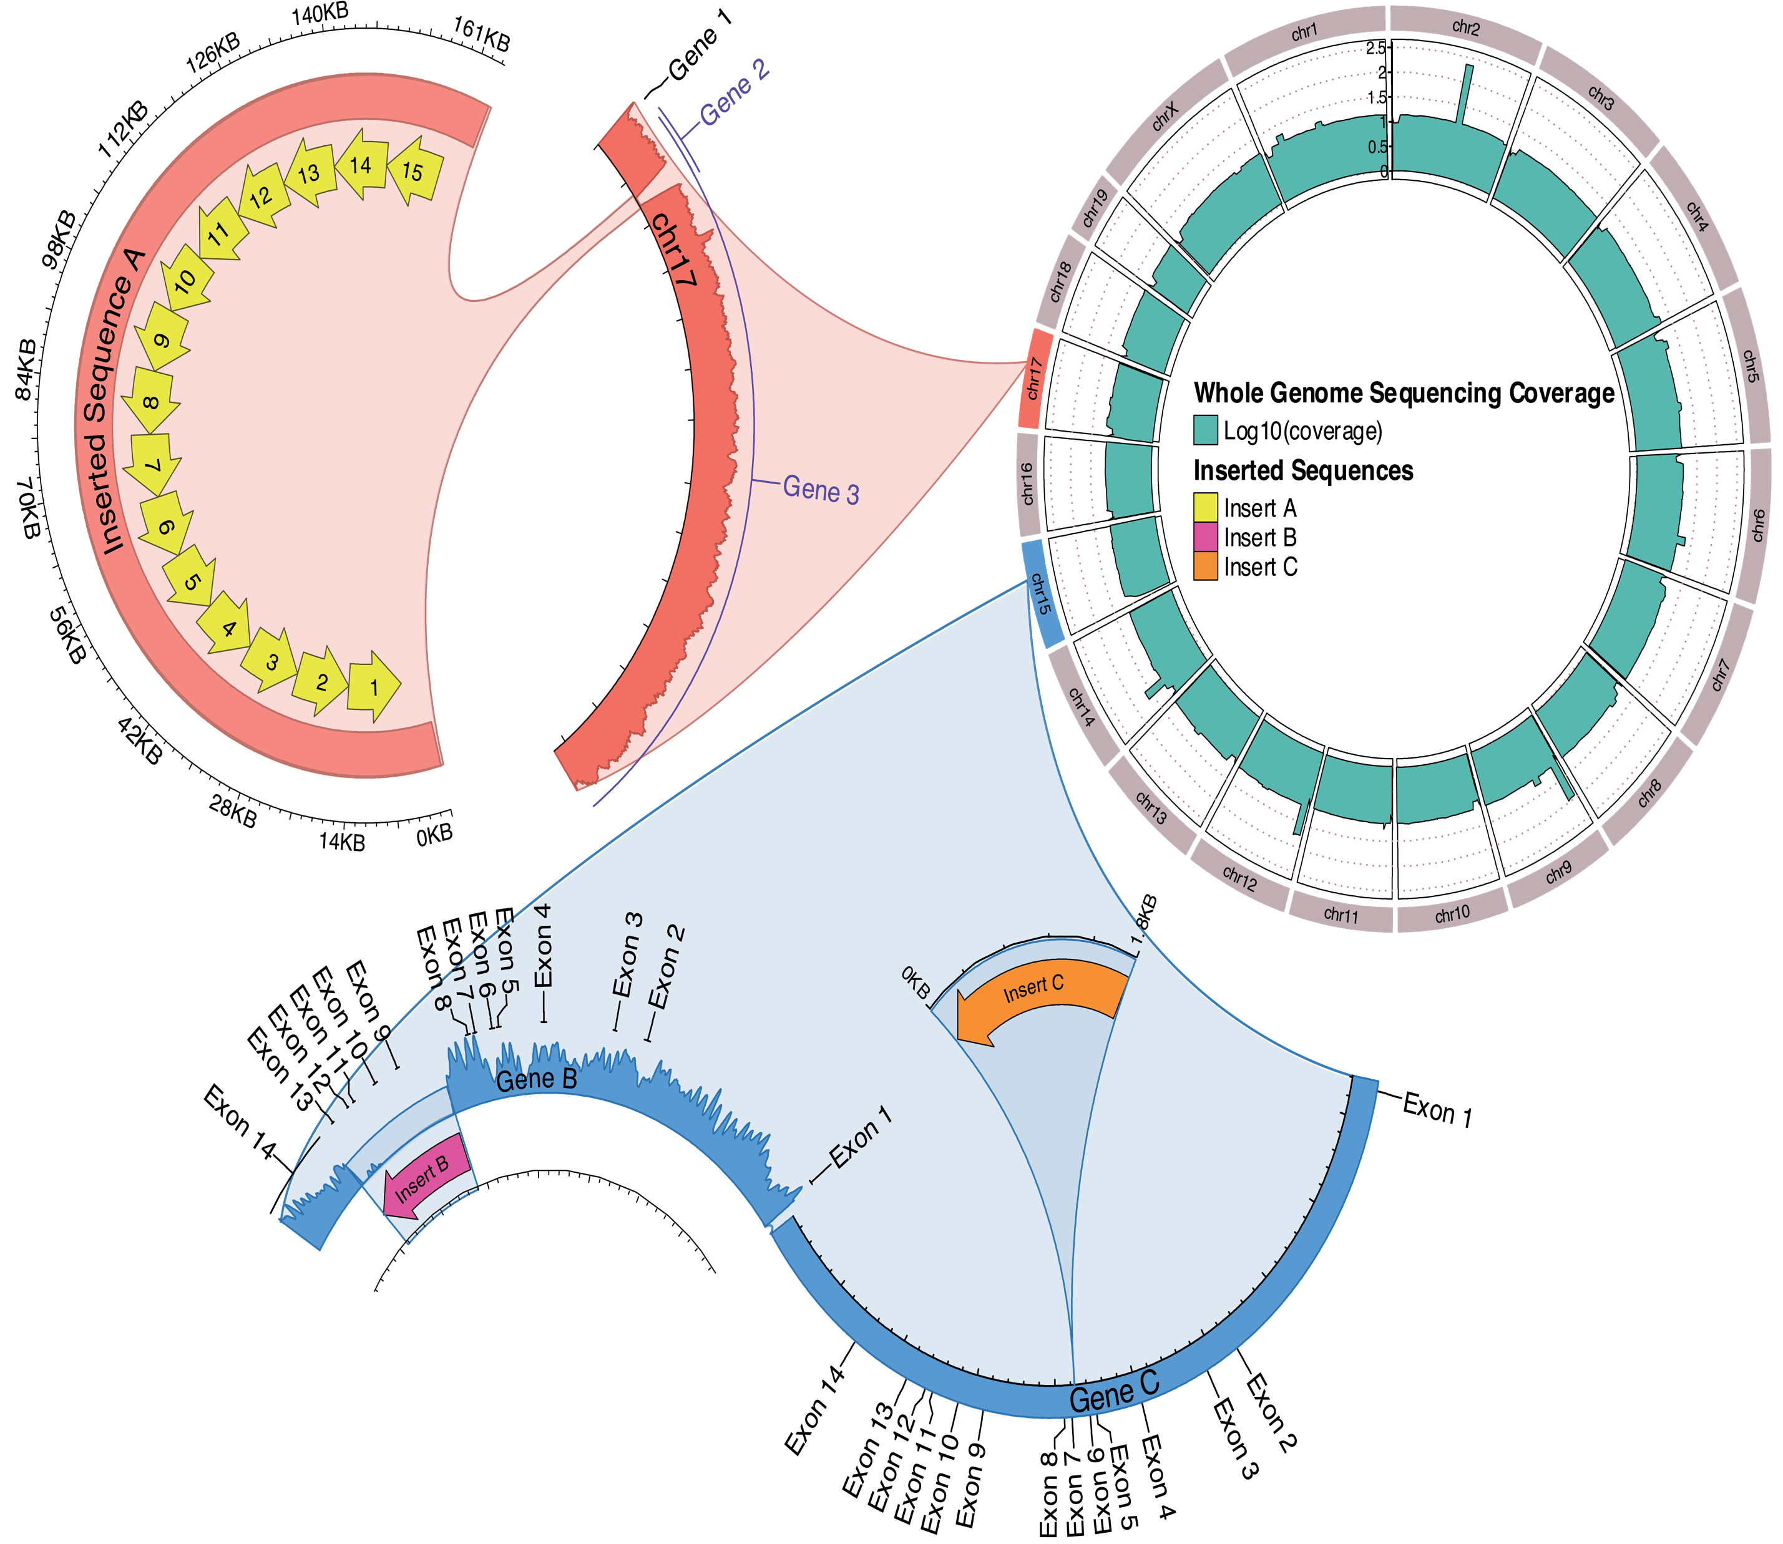
An example from a transgenic mouse model

Slide 7
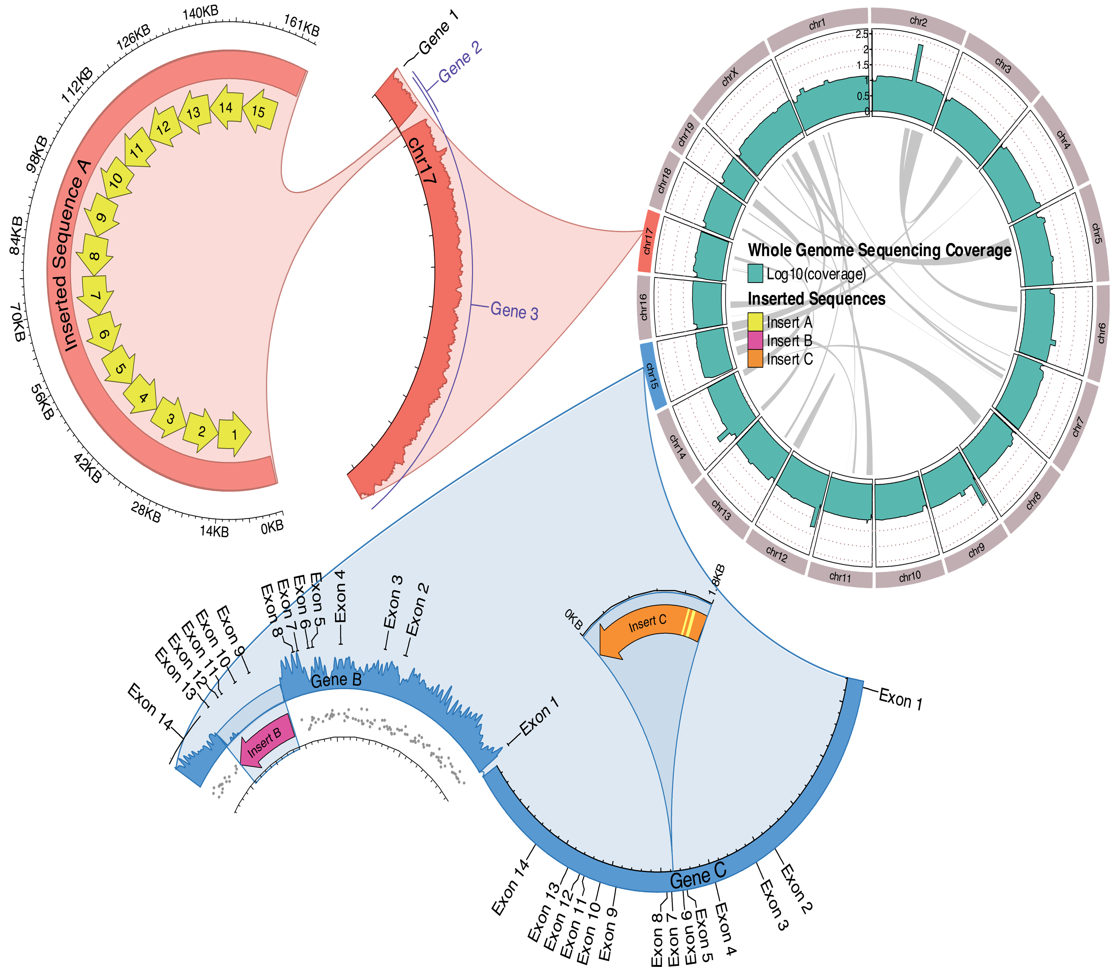
An example from a transgenic mouse model

Slide 8
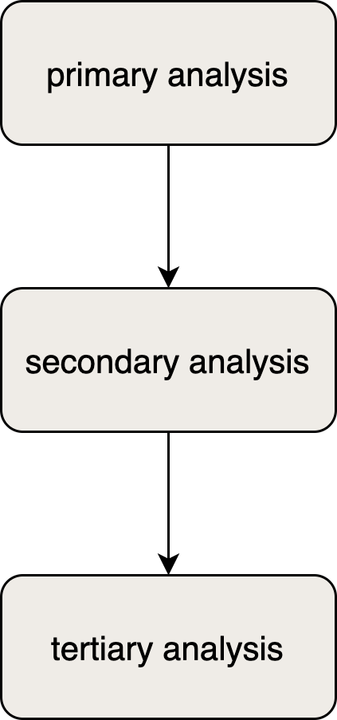
Uses of gmoviz in biotech research
Cell line development
Transgenic animal model development
Viral integration site analysis
Genomic characterisation (flu-genome screening)
Viral reassortment

Slide 9
Summary
Circular plots are an ideal method of representing high-dimensional genomic variation data (SVs, CNVs, indels, SNVRs etc.)
The gmoviz package makes it easy to generate elegant, integrative visualisations using the existing Bioconductor ecosystem
gmoviz is available from Bioconductor (https://bioconductor.org/packages/release/bioc/html/gmoviz.html)

Slide 10
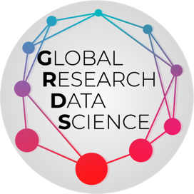



Acknowledgements
Arthur Hsu
Jia Hong Fong
Monther Alhamdoosh
Milica Ng
UROP program
Honours program

